Slide 1



Designing sustainable and friendly urban space
for and with children
PART 2. - exercises
Beata Patuszyńska

Slide 2
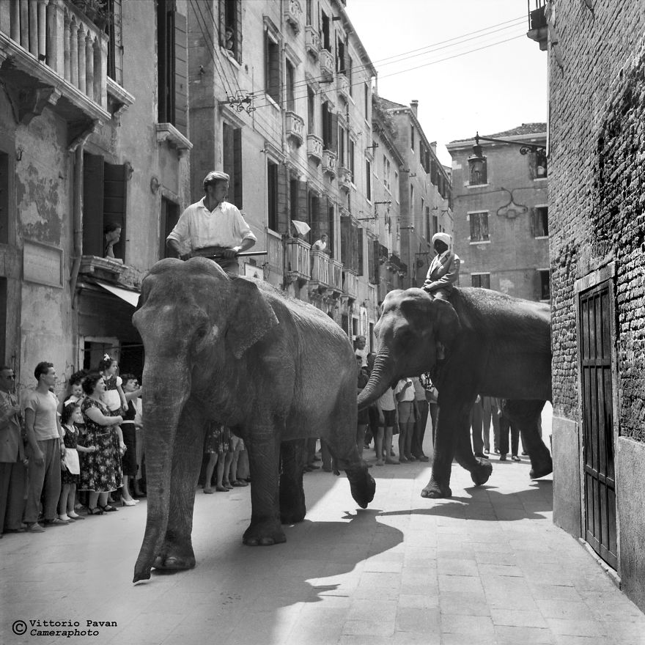
Part 2. exercises
„The cities built so far have been designed for elephants, not for people.”
Jan Gehl
And how do children feel in such cities?

Slide 3
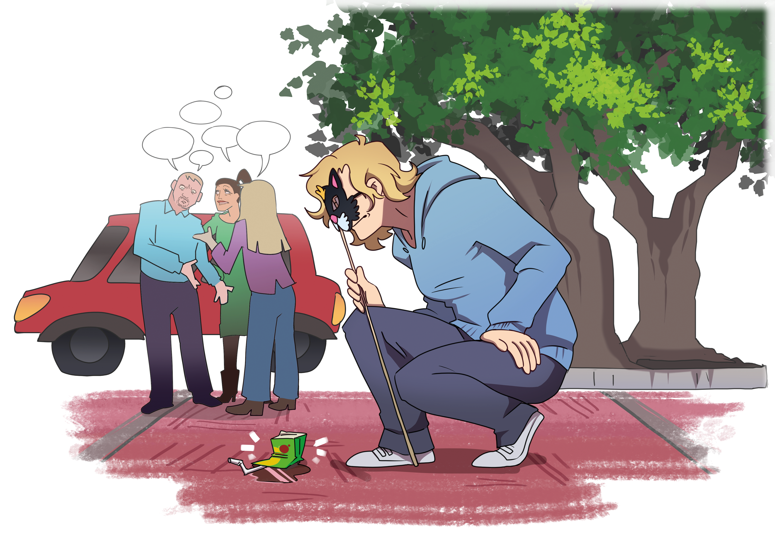
EXERCISE 1
In this exercise, you will see the space from the height of a 7-year-old child – about 115 cm above the ground.
This will help you feel how a child perceives the world: what they see, what they don’t, what they feel, what attracts them, and what intimidates them.
Find out where this exercise came from.
Il. Marianna Dziemska, to the book „City for children. A guide for explorers”

Slide 4
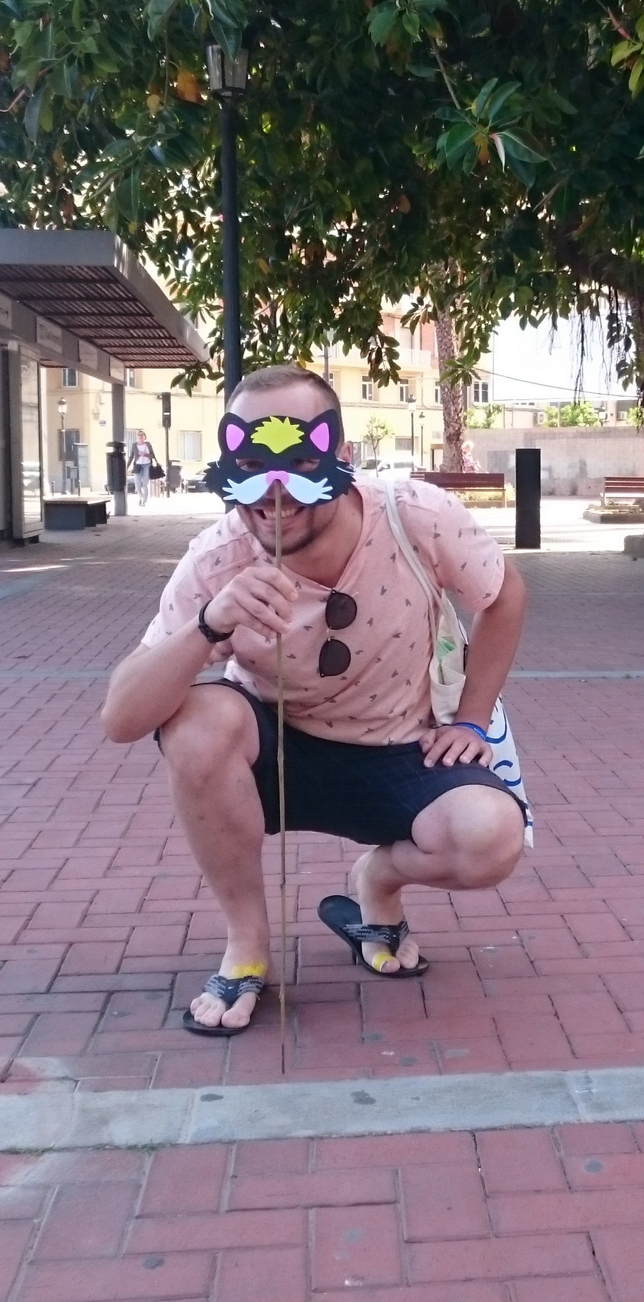
Background of the exercise
An exercise by the Dutch Bernard van Leer Foundation as part of the Urban95 project – originally designed for 3-year-olds, that is, children about 95 cm tall.
I adapted it to the height of 7-year-old children (whose eye level is about 115 cm), because that’s the age when they begin their urban independence.
Photo: Beata Patuszyńska

Slide 5
Urban95
Urban95 is a global initiative aimed at creating cities that are friendly to young children and their caregivers.
The initiative focuses on designing spaces that are friendly to a 3-year-old — that is, from the perspective of 95 cm in height.
The program supports the healthy development of the youngest city residents by improving access to services, facilitating mobility, creating child-friendly public spaces, and training urban leaders, among others, as part of Urban95 Academy.

Slide 6
Purpose of the exercise
The purpose of the exercise is to:
  experience urban space from a child’s perspective,
  notice what can be seen, what cannot, and how the perception of the surroundings changes,
  consider what could be improved to make it more child-friendly.
Time: 30–45 minutes (basic version)
Format: individual exercise (or together with a child)

Slide 7
Materials needed
In the next part, I’ll suggest different versions of this exercise
VERSION 1: Do you want to see what it looks like when you ‘disconnect’ your wide field of vision?
VERSION 2: Do you have a child you’d like to do this exercise with? Make the tool together and explore the space jointly!
VERSION 3: Can’t or don’t want to squat? Do the mini version.
To do the exercise, prepare:
an umbrella or a stick – measure and mark the height of 125 cm on it,
a notebook and something to write with, or a phone – to record your impressions or take photos,
(optional – version 1) two cardboard tubes, e.g. from toilet paper rolls,
comfortable clothing – you’ll be squatting and observing your surroundings.
REMEMBER! It’s not about exact centimeters – we want to see through children’s eyes, and they also differ in height.
The most important thing is that you can look at the world from a less adult height.

Slide 8
Step 1: Look through the eyes of an adult
Go out into the city. For now, you are an adult. Stop for a moment.
Look around from your natural height. Stand straight and observe the area around you.
Write down or say to yourself:
  What do you see, hear, feel?
  How do you feel?
  Do you like it here? Does something bother you? What the most? What the least?
  Pay attention to the aspects we mentioned earlier: aesthetics, safety.
Take 3–5 minutes for calm observation.
Not sure which places to choose?
Check the suggestions.

Slide 9
Suggested places:
parking lot with cars – it can be near a school – notice what you see when standing right in front of a car, how do you feel then? Would you be able to see the driver’s face when crossing the street?
ice cream food truck – can the vendor see you over the counter? Can you manage to order ice cream? Will it be easy to receive it from the seller? To pay?
crosswalk/traffic lights – is it easy to cross the street in the city center? Do adults block the crosswalk? Can you make it across during one green light?
near a busy intersection – how do you feel when cars pass by? What do you hear? Do you notice any different smells?
public transport stop – can you see the timetable? Is it easy for you to get on the bus? Do adults let you board?
busy street, pedestrian zone – does anyone notice you? Has anyone bumped into you? How do you feel when adults are bigger, there are many of them, and they talk loudly?
stairs to the metro or underpass – how do you feel looking down at them? And how about being at the bottom and having to climb or go up them?
entrance to your building – can you reach the intercom?
street with high shop windows – how do you feel when you can’t see what’s on display? Do you get bored? Would you rather see and look at the shop windows, or does it not matter to you?
bench in the park – look around it. Maybe you’ll notice an insect climbing up a flower stem, or maybe cigarette butts lying under the bench. How do you feel then?

Slide 10
Step 2: See the world through a child’s eyes
Take a stick or an umbrella and hold it upright. Squat next to it. Your eyes should be roughly at the marked height of 125 cm. This is your new point of view.
Look around:
  What do you see, hear, feel? How has the environment changed?
  How do you feel? Do you like it here? Does something bother you? What the most? What the least?
  Pay attention to the aspects we mentioned earlier: aesthetics, safety.
  Take 3–5 minutes for calm observation.
Write down notes or take a photo from this perspective.

Slide 11
EXERCISE VERSIONS
VERSION 1:
Do you want to see what it looks like when you ‘disconnect’ your wide field of vision?
VERSION 2:
Do you have a child you’d like to do this exercise with?
Make the tool together and explore the space jointly!
VERSION 3:
Can’t or don’t want to squat? Try the mini version.

Slide 12
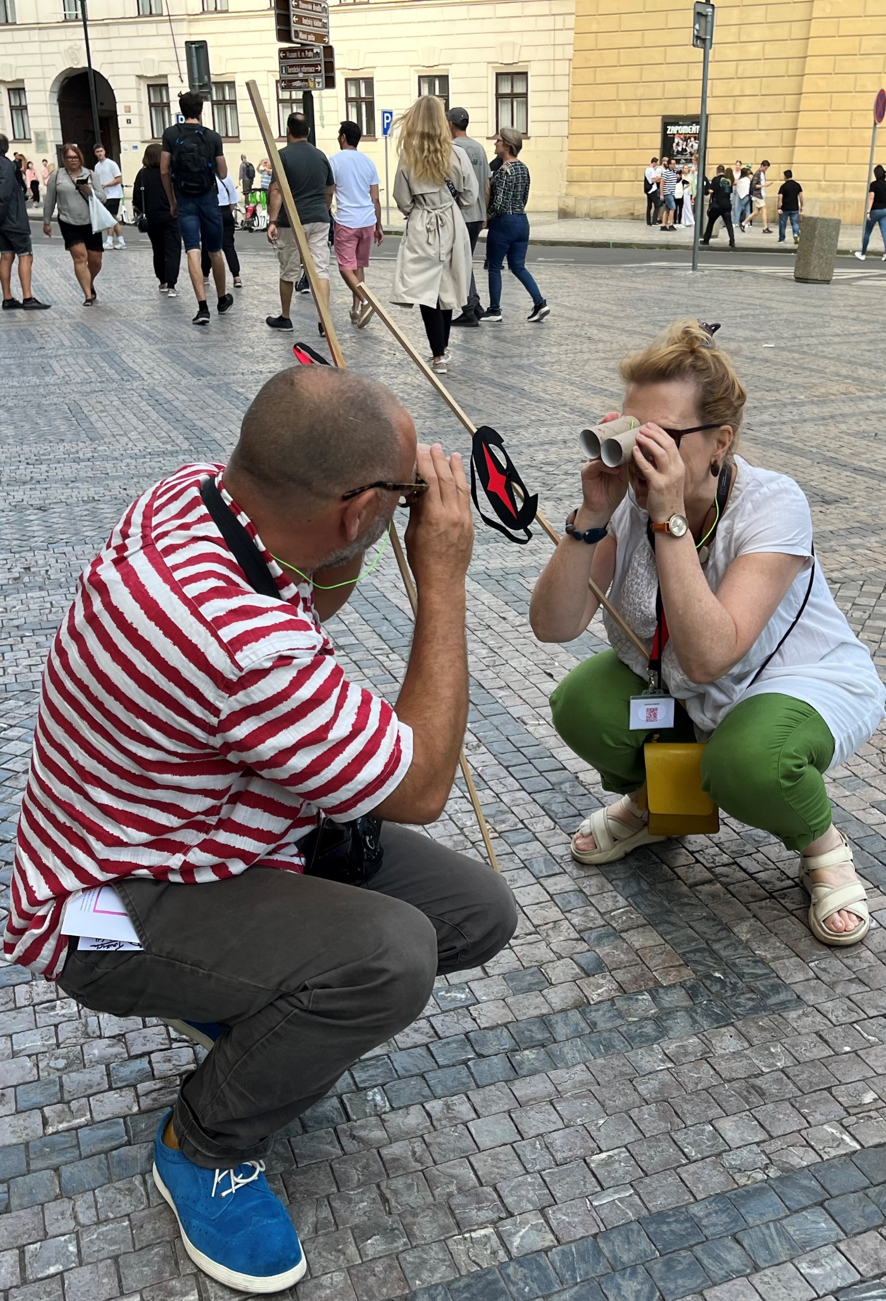
VERSION 1:
Limit your field of vision
Do you remember the studies by UCL and Birkbeck University of London saying that children process different visual signals separately? Try to feel it:
Take two toilet paper rolls or make ‘glasses’ with your hands.
Look around through them – walk for a moment or observe the same place. Squat down.
Write down:
  What can you see now, and what can’t you?
  How do you feel with such limited vision?
  Is it easy to notice an approaching car, people, or signs?
This is how a child ‘loses’ part of the information from their surroundings – especially in a busy, chaotic environment.
Photo: Beata Patuszyńska

Slide 13
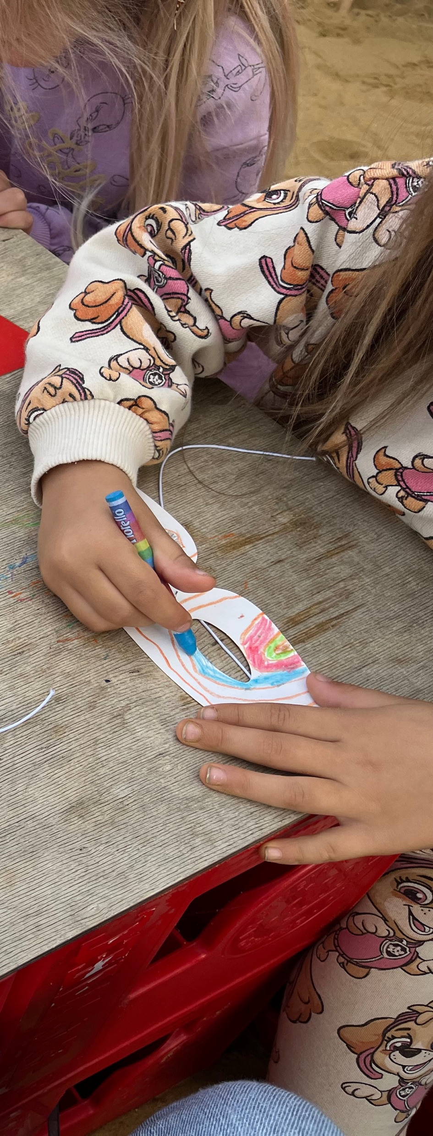
VERSION 2: Do it together
If you want to do the exercise together with a child:
Cut out a mask from paper or cardboard together.
Let the child decorate it – let them show you how they see the world.
Attach the mask to a stick or umbrella at the child’s eye level, e.g. with double-sided tape or a pin.
Go out into the city together – let the child be your guide.
Write down what the child notices that you don’t..
Photo: Beata Patuszyńska

Slide 14
VERSION 3: If you can’t or don’t want to squat
If you can’t or don’t want to squat, you can take photos at the height of 115 cm.
Set up a camera or phone on a tripod, or hold it at chest level.
Take several shots from different places: e.g. at a pedestrian crossing, bus stop, shop, or bench.
Look at the photos you took and try to notice:
  What is within the field of view?
  What new things do you see, and what can’t be seen?
  What impression does the urban space make from this perspective?

Slide 15
Step 3: Compare the two perspectives
Stand up straight again and think:
  What can’t be seen / felt / heard at one height compared to the other?
  How is the adult’s world different from the child’s world?
  What might a child overlook, and what does the child notice more than you?
  What emotions does this experience evoke in you?
Write down your observations in a few sentences.

Slide 16
Reflection after exercise 1
Today, you’ve seen the city from a different perspective.
Think and write down:
  What surprised you?
  What emotions did the child’s perspective evoke?
  Maybe you noticed new details, barriers, sounds, or smells.
  What would you like to change in this space to make it more child-friendly?

Slide 17
EXERCISE 2
WHERE ARE THE CHILDREN IN YOUR CITY?
You already know what the world looks like from a child’s perspective.
Now let’s find out where children are truly visible in your city – and where they are not.
This exercise will help you understand how space, infrastructure, and culture influence the presence of children in the city.

Slide 18
Purpose of the exercise
The purpose of the exercise is to:
  identify child-friendly places,
  notice where children disappear from public spaces,
  reflect on why this happens.
Time: 30–45 minutes
Format: individual or with a child.

Slide 19
Step 1: Look around
Take a walk around your neighborhood. You can do this together with a child.
Pay attention to places where children might be present:
  playgrounds, parks, squares,
  sidewalks along quiet and busy streets,
  public transport stops,
  shops,
  schools.
If you are with a child, talk about it — would they like to use this space on their own? Why or why not?
Take notes.

Slide 20
Step 2: Where are the children – and where are they not?
Think about:
Where do you see children?
Where are they absent, even though they could be there?
Are the children here on their own, or with adults?
Why?
  Is it a matter of safety?
  Access?
  Culture?
  Design of the space?

Slide 21
Step 3: Analysis
Think about:
  What common features do child-friendly places share?
  What do the places without children have in common?
  What role do infrastructure, greenery, noise, visibility, and the sense of safety play?
Write down at least three observations.

Slide 22
Reflection after the exercises
Think about:
Which places in your neighborhood are truly child-friendly?
Where are there no children, and why?
What could change to make this place more accessible for the youngest and to support their independence?
Reflect and write down:
What surprised you the most?
What emotions did you feel while seeing the world through a child’s eyes?
What will you take from this experience into your work or project?

Slide 23
Congratulations!
You’ve just completed two exercises
on thinking about the city from a child’s perspective.
Keep your notes.
They will be useful in your parenting,
work, and everyday life in the city.

Slide 24

The project is supported by the Circular Bio-based Europe Joint Undertaking and its members.
Funded by the European Union. Views and opinions expressed are however those of the author(s) only and do not necessarily reflect those of the European Union or CBE JU. Neither the European Union nor the CBE JU can be held responsible for them.

